Slide 1
FIRST/SECOND/THIRD/SYNOPSIS Doctoral Committee Meeting
Ph.D. RESEARCH SCHOLAR
Name …….
Reg. No. :
Dept. of …….
HITS, Padur, Chennai.
GUIDE / SUPERVISOR
Dr. ……… Prof(…..)
Dept. of ……….
HITS, Padur , Chennai.
Date : 00.00.2021 Time: 00.00 AM/ PM
Venue: Online / Video Conferencing Platform (MS Team)
HITS, Padur-603103

Slide 2
RESEARCH EVENTS
Date of Registration :../ .…/20..
First DC meeting : ../…/20..
Course work Completed
Subject Code | Subject Title | Grade
Comprehensive Viva Voce examination : ../…/.20..
colloquium Meeting : ../…/.20…
Second DC meeting : .../.../20..

Slide 3
TITLE OF THE PH.D. THESIS
“ …………………………………………………………”

Slide 4
I N T R O D U C T I O N

Slide 5
REVIEW OF LITERATURE

Slide 6
RESEARCH GAP

Slide 7
OBJECTIVES
To ………..
To………..

Slide 8
RESEARCH DESIGN/METHODOLOGY/MATERIALS AND METHODS (Suitable title can be given)

Slide 9
RESULTS AND DISCUSSION

Slide 10
CONCLUSION

Slide 11
LIST OF PUBLICATIONS

Slide 12
REFERENCES

Slide 13
T H A N K Y O U

Slide 14
INTELECTUAL INTERARACTIONS

Slide 15
General points to be noted
All slides to be numbered
All figures should be numbered
All tables should be numbered
All equations should be numbered
Use Times new roman as font style and minimum font size as 24
Scholar should get corrections and approval from the supervisor before the meeting
For DC meetings, the progress report should be circulated at least 5 days before the scheduled meeting to the DC members with a copy to researchoffice@hindustanuniv.ac.in.
For synopsis meetings, the draft synopsis (Soft copy) and draft thesis (Softcopy) should be circulated at least 5 days before the scheduled meeting to the DC members with a copy to researchoffice@hindustanuniv.ac.in.

Slide 16
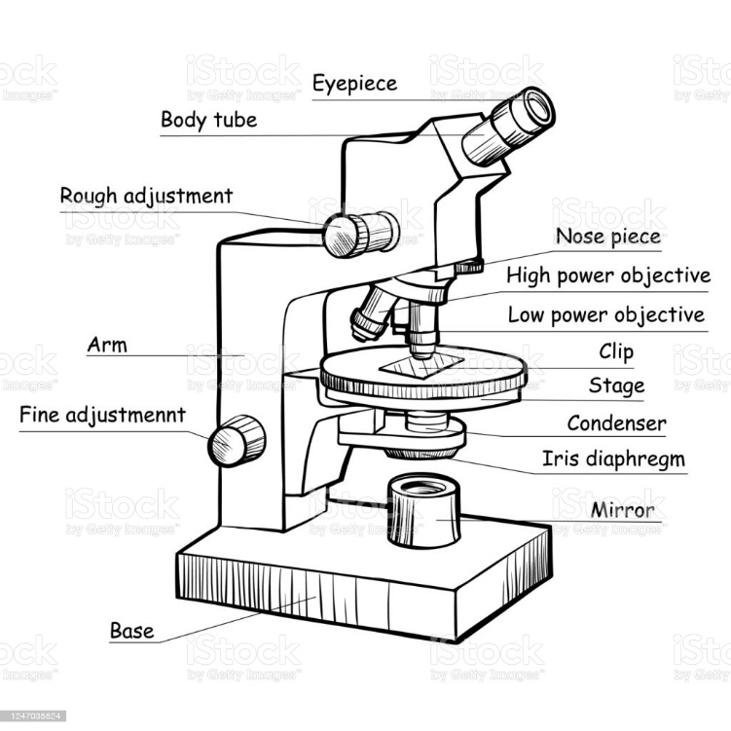
Sample figure template
Figure 1: Modern electronic microscope

Slide 17
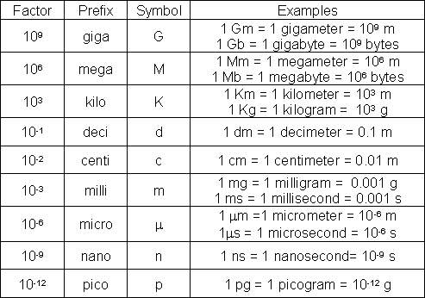
iStock
Modern Electronic Powerful Lab Microscope
Sample table template
Table 2: Common SI and Metric Prefixes

Slide 18
If I DC Meeting

Slide 19
COURSE WORK SUBJECTS
SUBJECT CODE | SUBJECT TITLE | L | T | P | C

