Slide 1

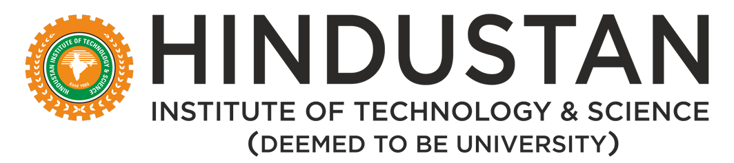
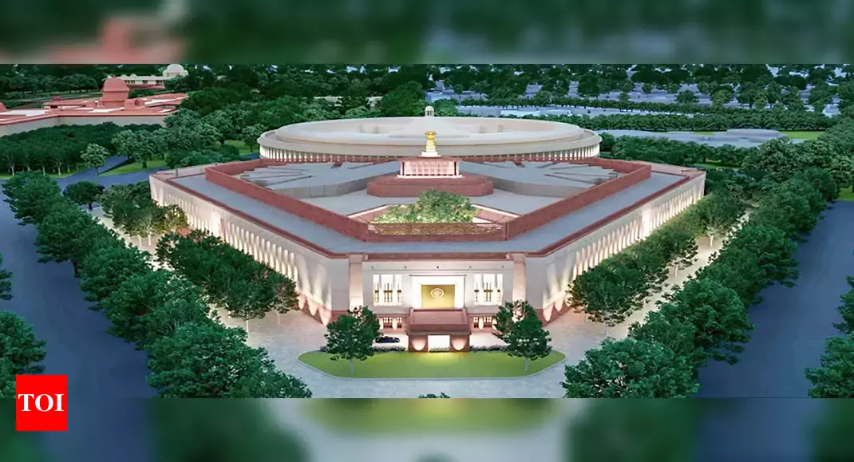

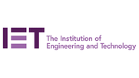

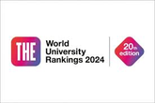

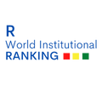
HINDUSTAN
INSTITUTE OF TECHNOLOGY & SCIENCE
(DEEMED TO BE UNIVERSITY)
School of liberal arts and applied sciences
Department of Political Science
Empowering Success Through Knowledge.
M.A. in Public Administration

Slide 2



About
the department
Master of Arts (Public Administration) in HITS:
The Master of Arts in Public Administration is a two-year program that aims at imparting a better understanding of policies and issues in the fields of public policy making, governance, and administration in India. It is the ideal program that can open up new avenues into leadership roles in policy making and public administration. The well-structured Program will impart the much-needed skills to learn, investigate, research, and develop a framework for public governance processes within the Indian democracy.
The Program will build on one's competencies and confidence for future roles in organizations of various types such as research-based institutions, academics, semi-government organizations, NGOs, International Agencies, PSUs, etc. It is also the best Program to study if one wishes to become an independent consultant. The aim of M.A. (Public Administration) is to provide comprehensive knowledge to the learners on the nature and relationship of State, Society and Administration. It will develop the conceptual faculties of the learners on various administrative theories, postulates, models, processes, methods, instruments, techniques, etc.

Slide 3
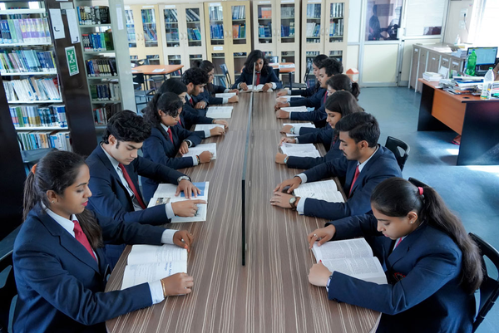

Eligibility:
50% in an Undergraduate (Bachelor) Program of a minimum duration of Three (3) years in any stream from a UGC recognized University. Candidates who are in the final semester of the Bachelor Program are also eligible to apply.
Duration: 2 Years (4 Semesters)
Core Courses:
Introduction to Public Administration: Covers the basic principles, theories, and concepts of public administration. Public Policy Analysis: Focuses on understanding the policymaking process, implementation, and evaluation. Organizational Behaviour and Management: Examines theories and practices related to organizational structure, behaviour, and management within public sector organizations. Public Budgeting and Finance: Covers budgetary processes, fiscal policies, and financial management techniques relevant to public administration. Research Methods in Public Administration: Provides studentswith the skills necessary to conduct research in public administration, including quantitative and qualitative methods.

Slide 4

MA Public Administration Future Scope
Introduction to Public Administration: Covers the basic principles, theories, and concepts of public administration. Public Policy Analysis: Focuses on understanding the policymaking process, implementation, and evaluation. Organizational Behaviour and Management: Examines theories and practices related to organizational structure, behaviour, and management within public sector organizations. Public Budgeting and Finance: Covers budgetary processes, fiscal policies, and financial management techniques relevant to public administration. Research Methods in Public Administration: Provides studentswith the skills necessary to conduct research in public administration, including quantitative and qualitative methods.

