Slide 1
Ph.D. PUBLIC VIVA - VOCE EXAMINATION
OF
NAME
Reg. No. :
DATE: , TIME:
VENUE: ONLINE / VIDEO CONFERENCING PLATFORM (MS Team) HITS, PADUR , CHENNAI– 603103

Slide 2
INVOCATION

Slide 3
ACKNOWLEDGEMENT
First and foremost, I would like to thank the Lord Almighty for His presence and immense blessings throughout the research work.
I am truly grateful to my supervisor Dr. ……., Professor, Department of …… Engineering for his valued interpretations, valuable guidance continuous motivation, innovative ideas, and constant support throughout my research

Slide 4
ACKNOWLEDGEMENT
I express my sincere gratitude to the Honorable Chancellor Dr. (Mrs.) Elizabeth Verghese, Pro-Chancellor Dr. Anand Jacob Verghese, Directors Dr. Aby Sam and Mr. Ashok Verghese for their encouragement and support in providing me the necessary research facilities and academic support for the successful research work.

Slide 5
ACKNOWLEDGEMENT

Slide 6
TITLE OF THE Ph.D. THESIS
“…………………..”

Slide 7
I N T R O D U C T I O N

Slide 8
REVIEW OF LITERATURE

Slide 9
RESEARCH GAP

Slide 10
OBJECTIVES
To ………..
To………..

Slide 11
RESEARCH DESIGN/METHODOLOGY/MATERIALS AND METHODS (Suitable title can be given)

Slide 12
RESULTS AND DISCUSSION

Slide 13
CONCLUSION

Slide 14
LIST OF PUBLICATIONS ARISING FROM THE WORK

Slide 15
T H A N K Y O U

Slide 16
INTELECTUAL INTERARACTIONS

Slide 17
REFERENCES

Slide 18
General points to be noted
All slides to be numbered
All figures should be numbered
All tables should be numbered
All equations should be numbered
Use Times new roman as font style and minimum size as 24
Scholar should get corrections and approval from the supervisor before the Ph.D. public Viva voce examination
Final PPT should sent to researchoffice@hindustanuniv.ac.in atleast two days before the scheduled Ph.D. public Viva voce examination
Prepare the presentation for 30 to 40 minutes

Slide 19
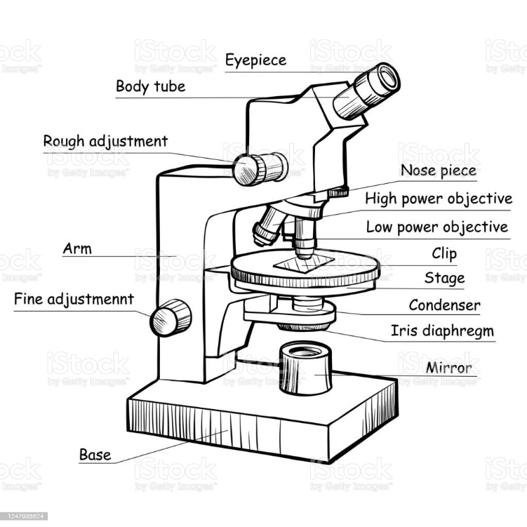
Sample figure template
Figure 1: Modern electronic microscope

Slide 20
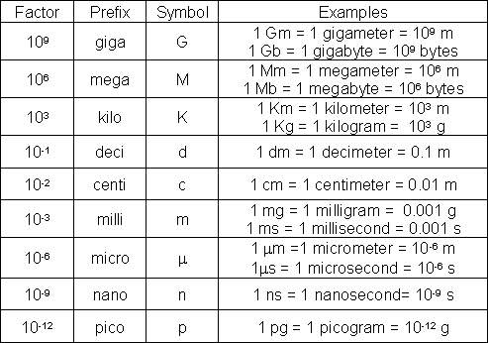
Sample table template
Table 2: Common SI and Metric Prefixes

